Slide 1

Machine Learning: Hotel Reservation Cancellation Prediction Exploring Predictive Models for Hotel Booking Cancellation Anticipation
Sai Mohan Anjesh
Aditya Dasari
05/05/2024

Slide 2
Objectives
Develop machine learning models to predict the likelihood of customers honoring hotel reservations.
Utilize a comprehensive dataset to discern patterns and factors influencing reservation outcomes.
Explore multiple machine learning algorithms.

Slide 3
Dataset
Booking_ID
no_of_adults
no_of_children
no_of_weekend_nights
no_of_week_nights
type_of_meal_plan
required_car_parking_space
room_type_reserved
lead_time
arrival_year
arrival_month
arrival_date
market_segment_type
repeated_guest
no_of_previous_cancellations
no_of_previous_bookings_not_canceled
avg_price_per_room
no_of_special_requests
booking_status

Slide 4
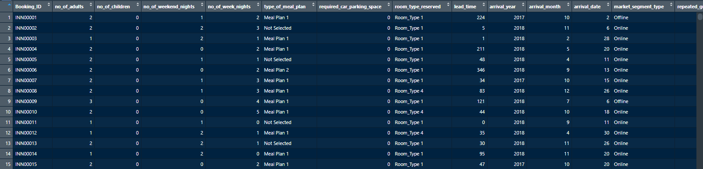
Data Exploration and Preprocessing - Overview
Dataset overview:
19 features, 36275 observations
Time span: July 2017 to December 2018
No demographic information available
Feature types:
Numerical: 14 features
Categorical: 5 features
Assumption: Prices are in USD $

Slide 5
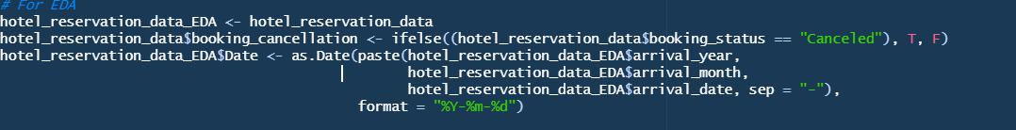
Data Exploration and Preprocessing – The Discrepancies
Identified issues: Zero-priced instances
Date discrepancy: Feb 29, 2018
Approach to resolution:
Analysis of adjacent dates (Feb 28, Mar 1)
Update of 37 records from Feb 29 to Mar 1
Date | Total number of records
2018-02-28 | 165
2018-03-01 | 61

Slide 6
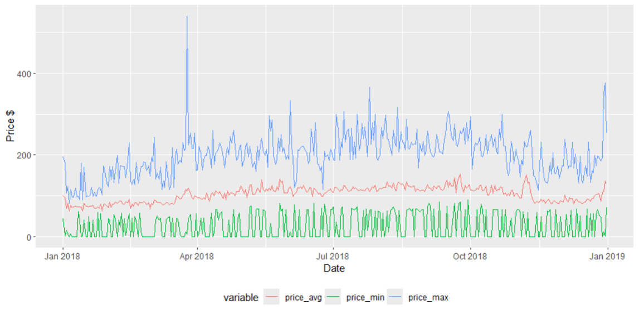
Data Exploration and Preprocessing – The Discrepancies (cont…)
Observation:
Not all prices are zero on a given date
Market segmentation of zero-price cases:
Online
Complimentary
Hunch:
Free hotel rooms or online offers result in zero prices
Analysis revealed that only 6 out of 546 zero-priced cases were cancelled.
Suggested reason:
Human tendency to avoid cancelling free hotel room bookings.

Slide 7
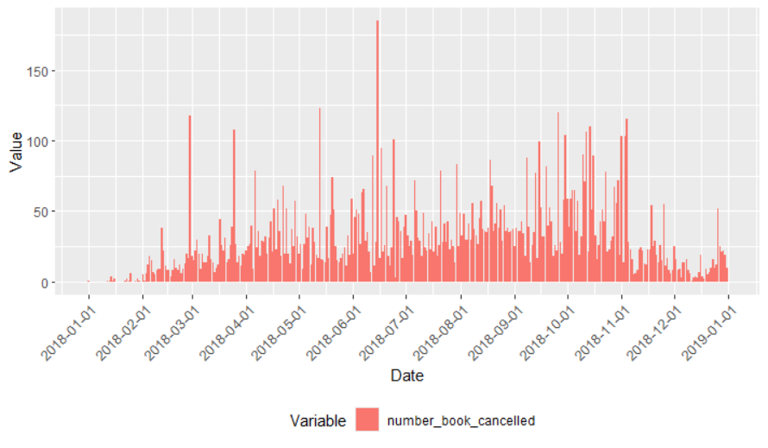
Data Exploration and Preprocessing – What about the booking cancellations?
Next focus on:
Total cancellations per day (sample from 2018)
Transformation:
Outcome variable to booking_cancellation from booking_status
It appears that there were numerous cancellations in the months of September, October, and November

Slide 8
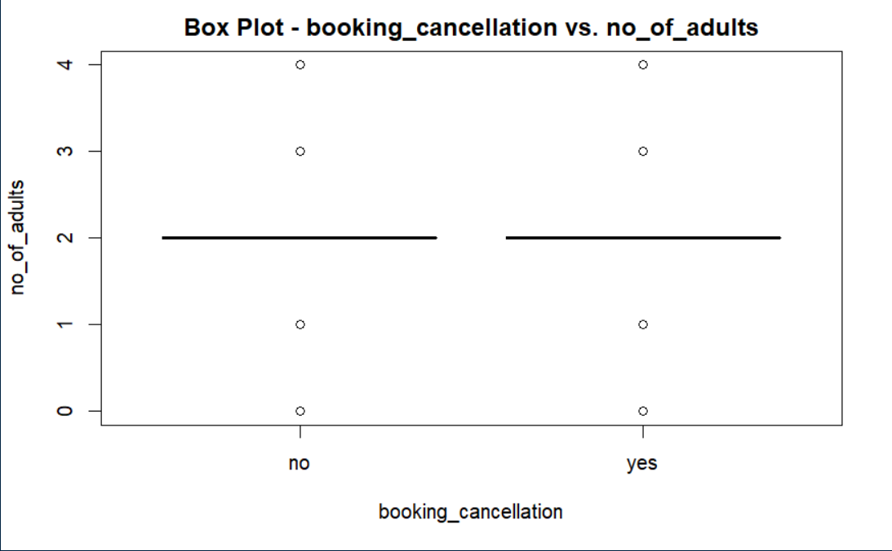
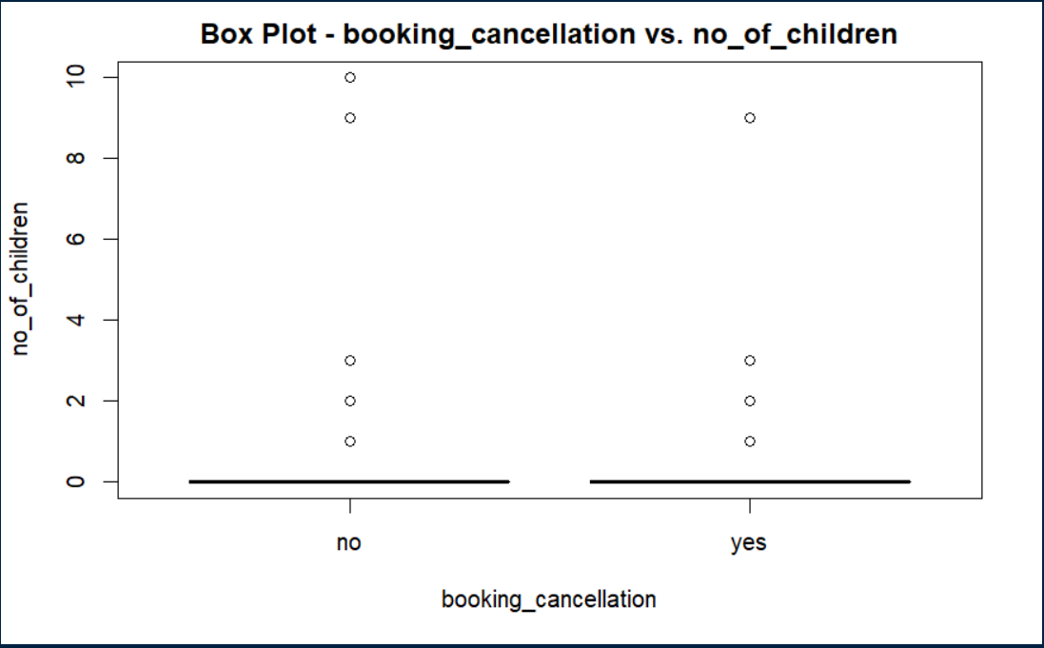
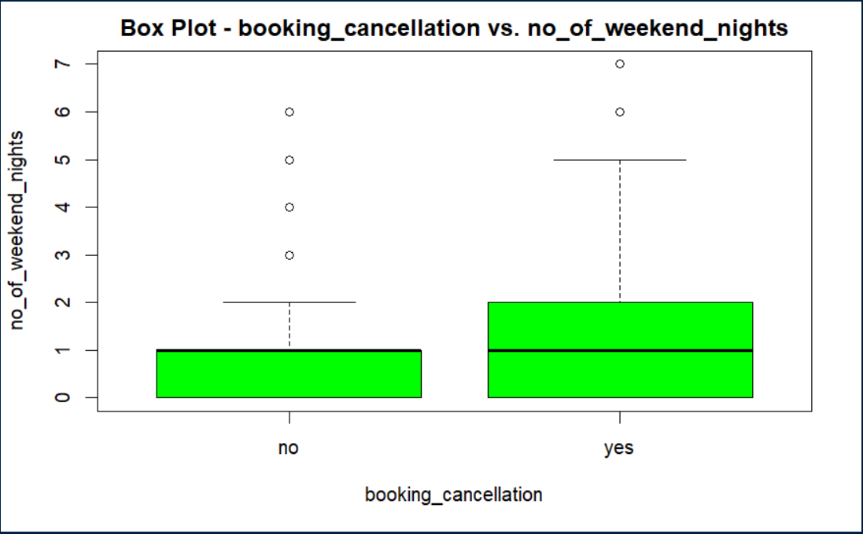
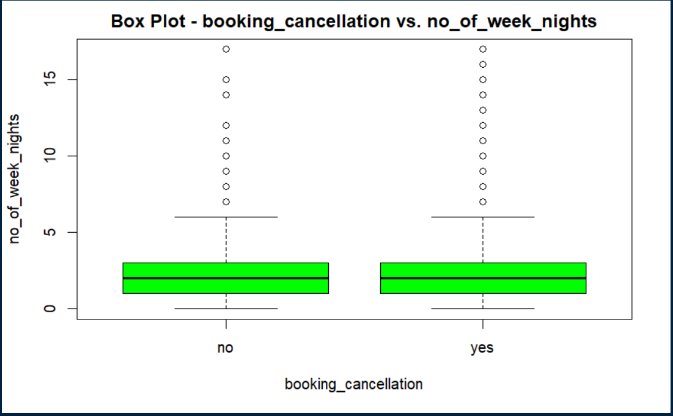
Data Exploration and Preprocessing - on Relationship between Variables and Cancellations

Slide 9
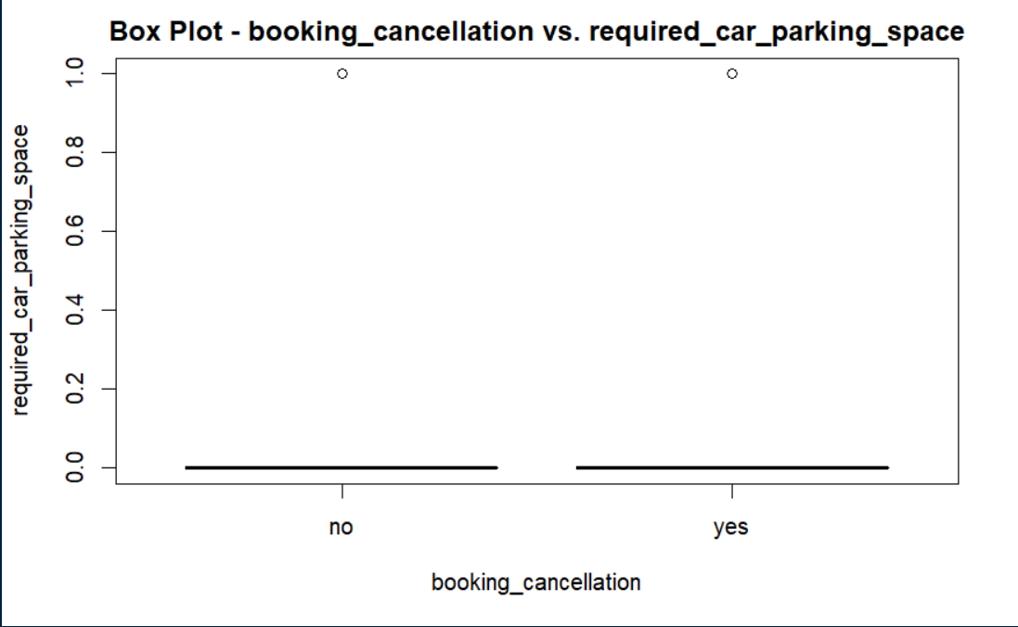
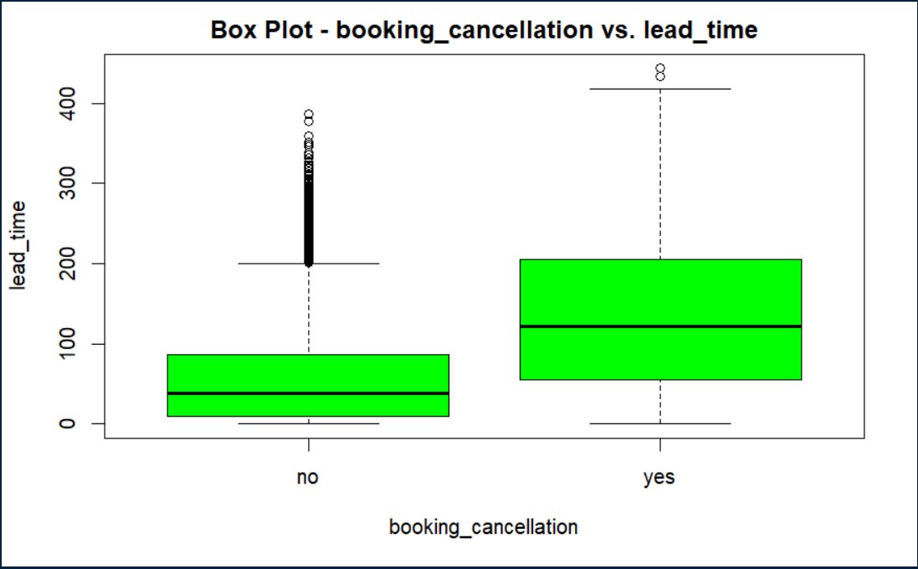
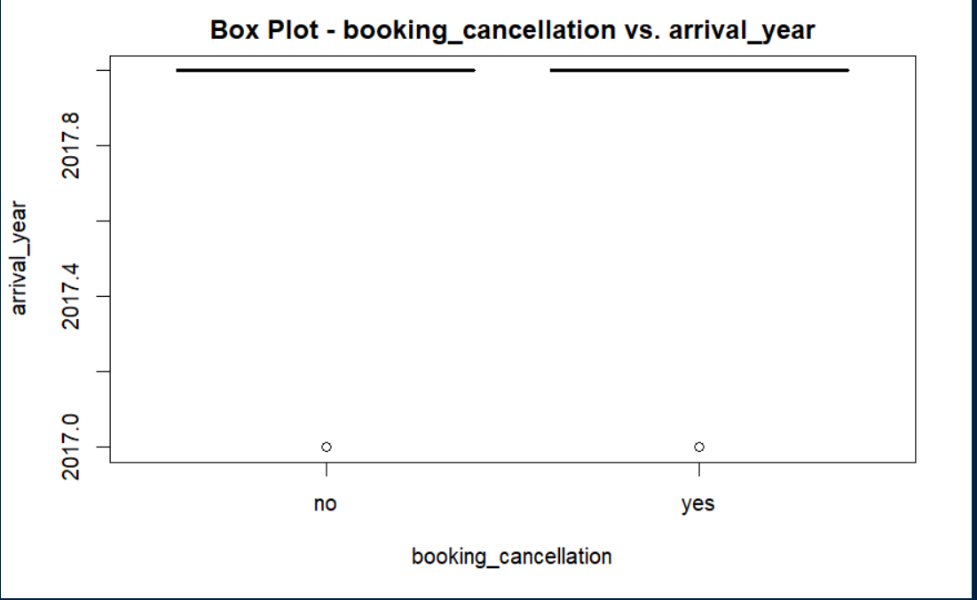
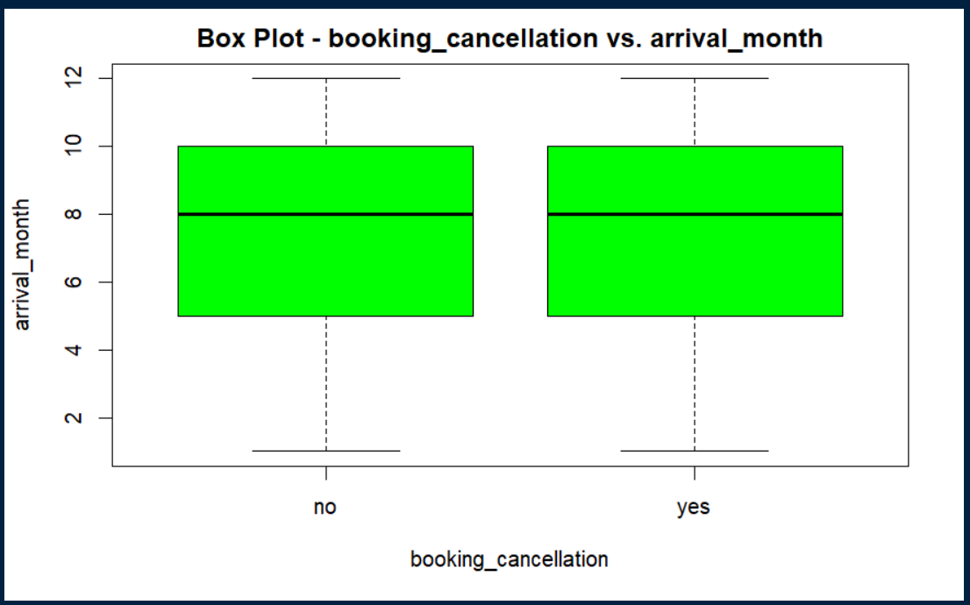
Data Exploration and Preprocessing

Slide 10
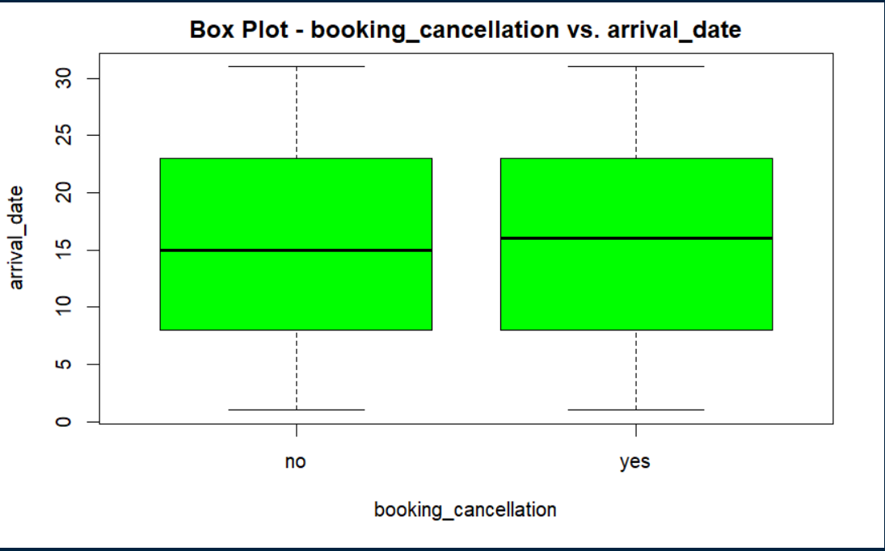
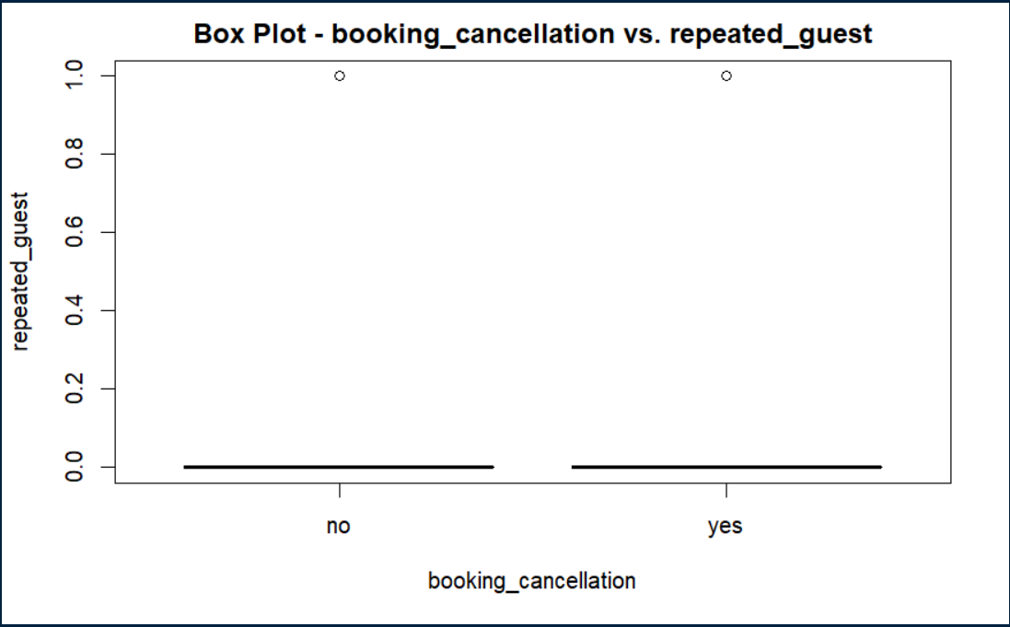
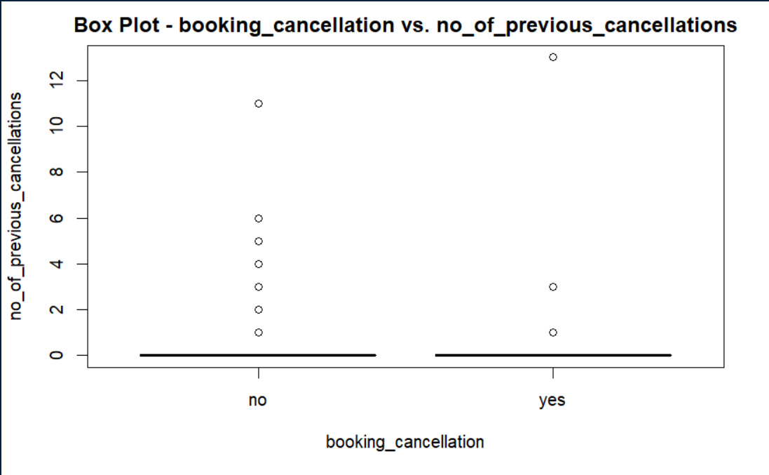
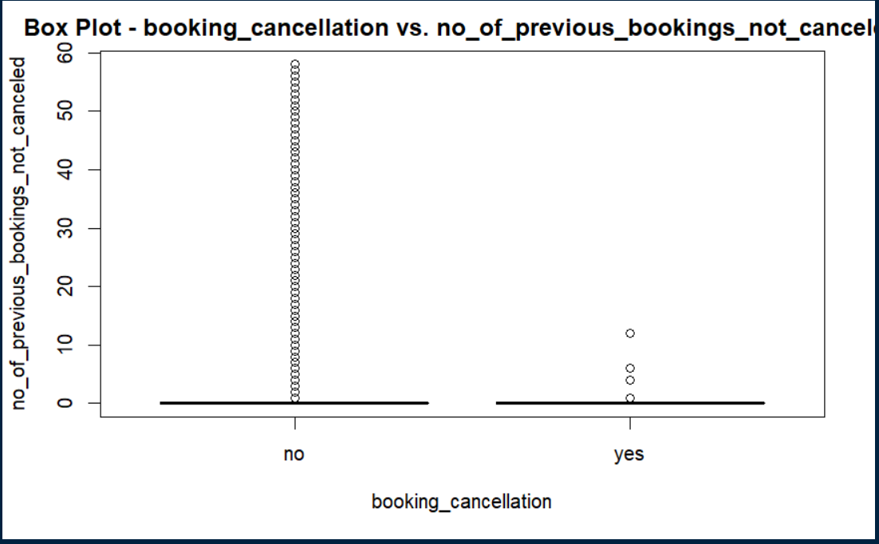
Data Exploration and Preprocessing

Slide 11
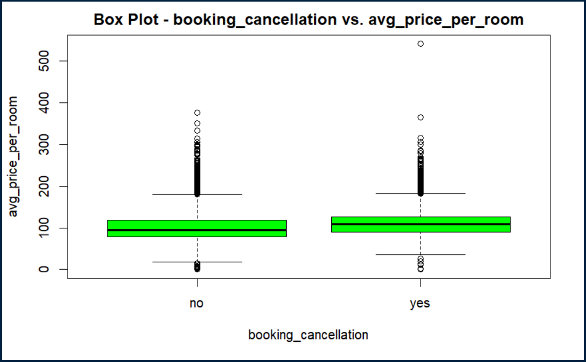
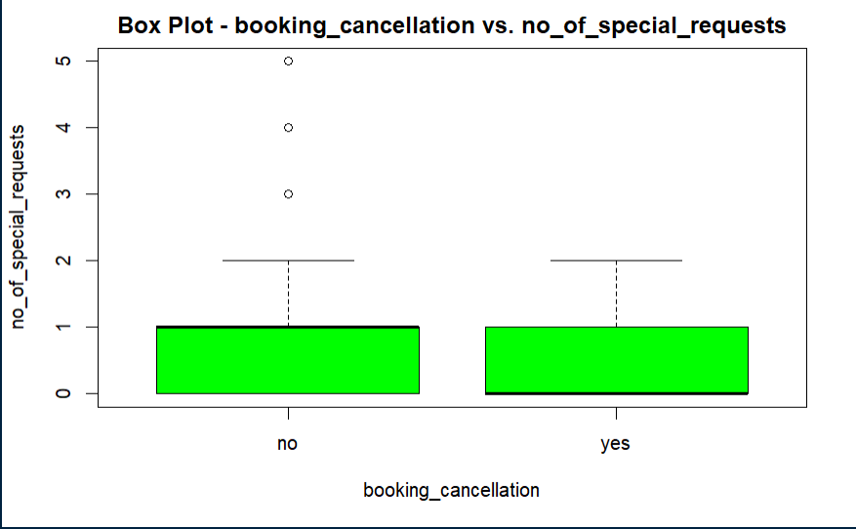
Data Exploration and Preprocessing

Slide 12
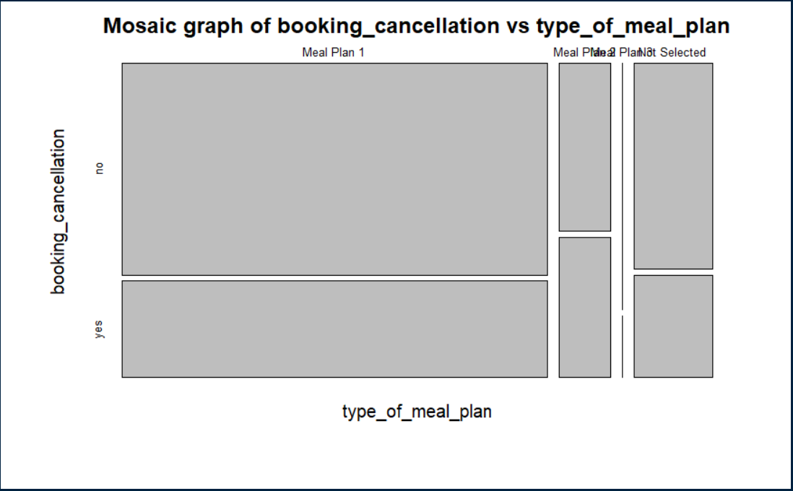
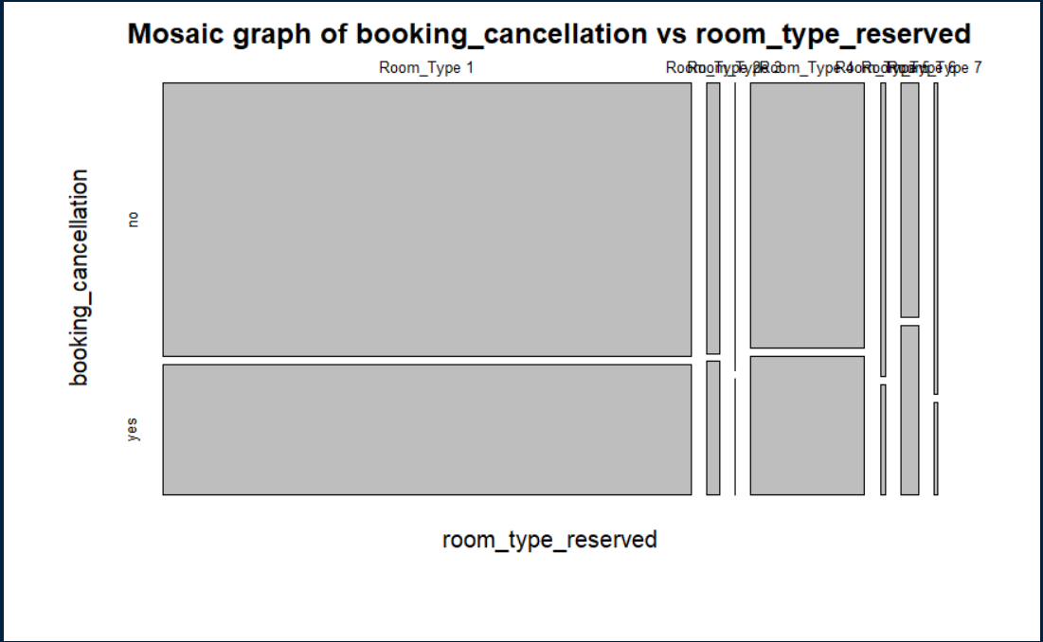
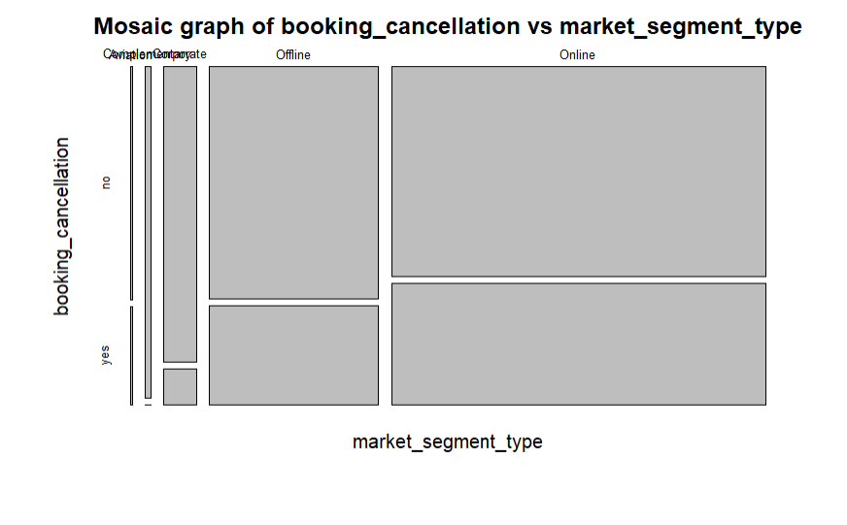
Data Exploration and Preprocessing

Slide 13
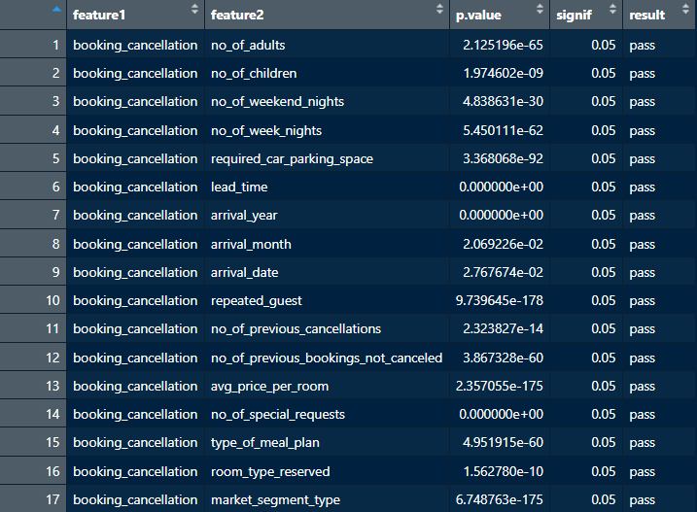
Data Exploration and Preprocessing

Slide 14
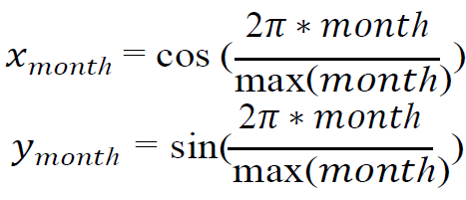
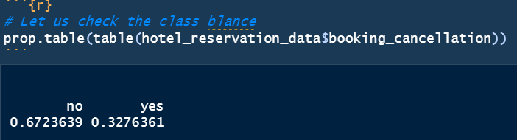
Data Exploration and Preprocessing - Feature Transformation and Model Data Preparation
Arrival_date and arrival_month features tranformed
Class balance check of 'booking_cancellation'
Imbalance identified, class weights used
Dataset partition: 90% training, 10% test
Preprocessing for neural network:
Validation dataset creation
One-hot encoding of categorical columns
Normalization of numerical columns

Slide 15
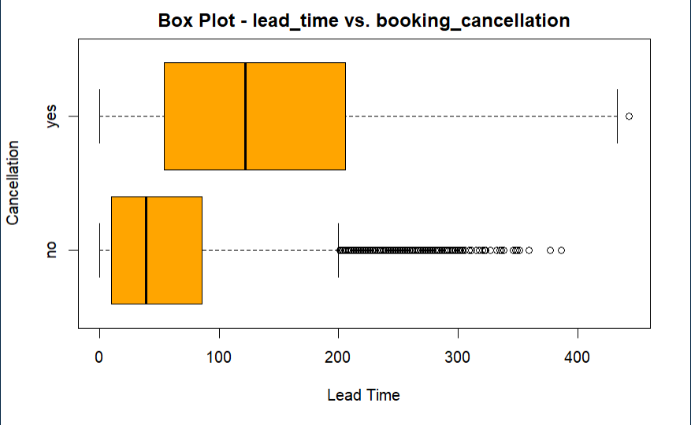
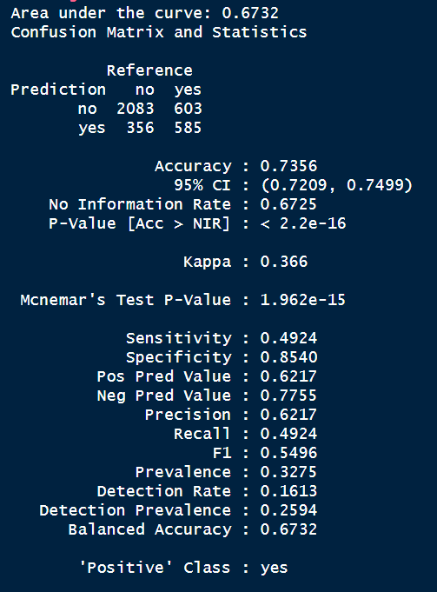
Modeling: Benchmark Model
Before proceeding with modeling techniques, we conducted a basic heuristic calculation and established a benchmark model. Analyzing the lead time feature, we found significant statistical differences in the mean values across different levels of the categorical variable (i.e., booking_cancellation), as indicated by the box plot analysis.

Slide 16
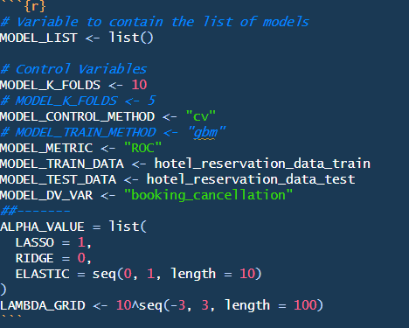
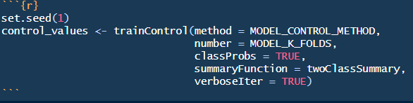
Modeling:
The next step involved constructing advanced models. The models employed were as follows:
Regularized Logistic Regression
Lasso Regularization
Gradient Boosted
Random Forest
Support Vector Machine
Linear
Radial
Neural Network
We are setting up parameters ahead of modeling

Slide 17
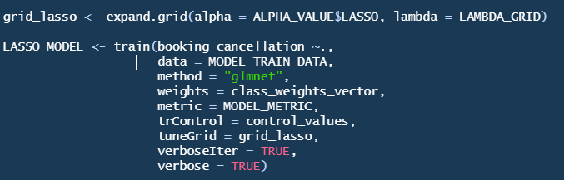
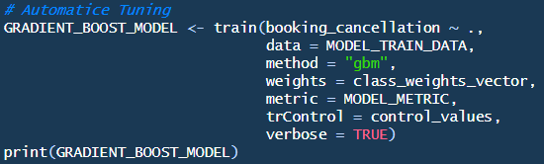
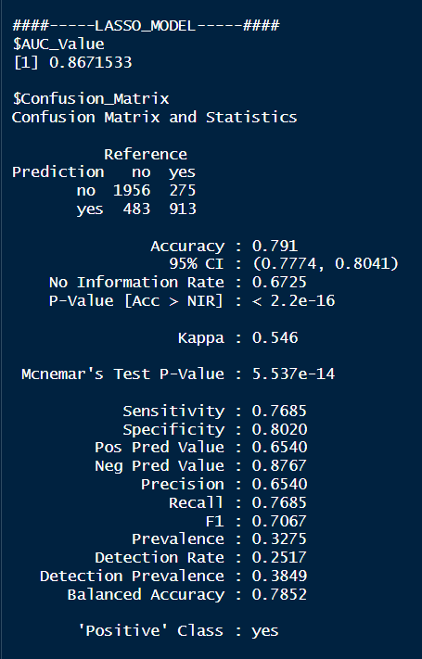
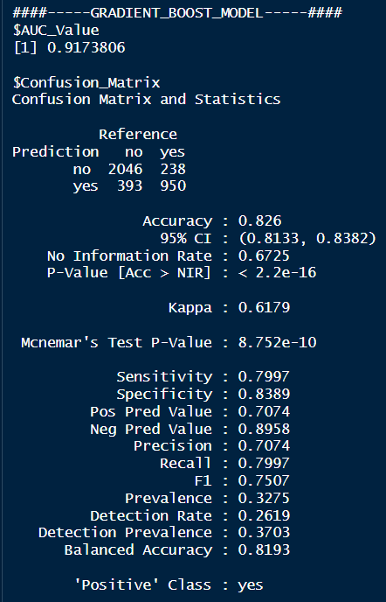
1. Regularized Logistic Regression – Lasso:
2. Gradient Boost Model:
This model was automatically tuned.
Performed hyperparameter tuning by adjusting lambda with 100 values between 10^-3 and 10^3.

Slide 18
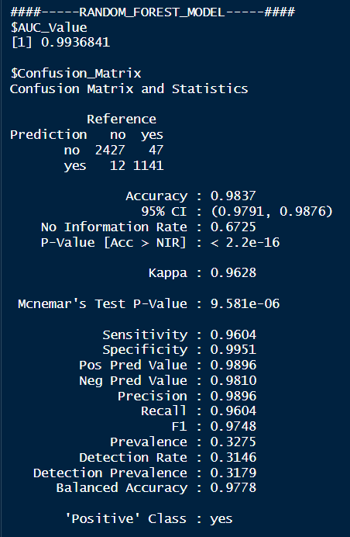
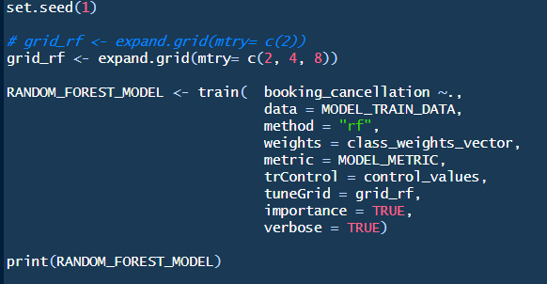
3. Random Forest Model:
Performed manual hyperparameter tuning with ‘mtry’ picking any of these values (2, 4, 8).
So far this model has performed well. Let us see other models too!
We have confirmed that our hypothesis regarding exploratory data analysis (EDA) was correct. During the EDA process, we observed a strong correlation between the lead time, average price, and number of special requests with our outcome variable. This suggests that these variables may be significant in predicting the outcome variable.

Slide 19
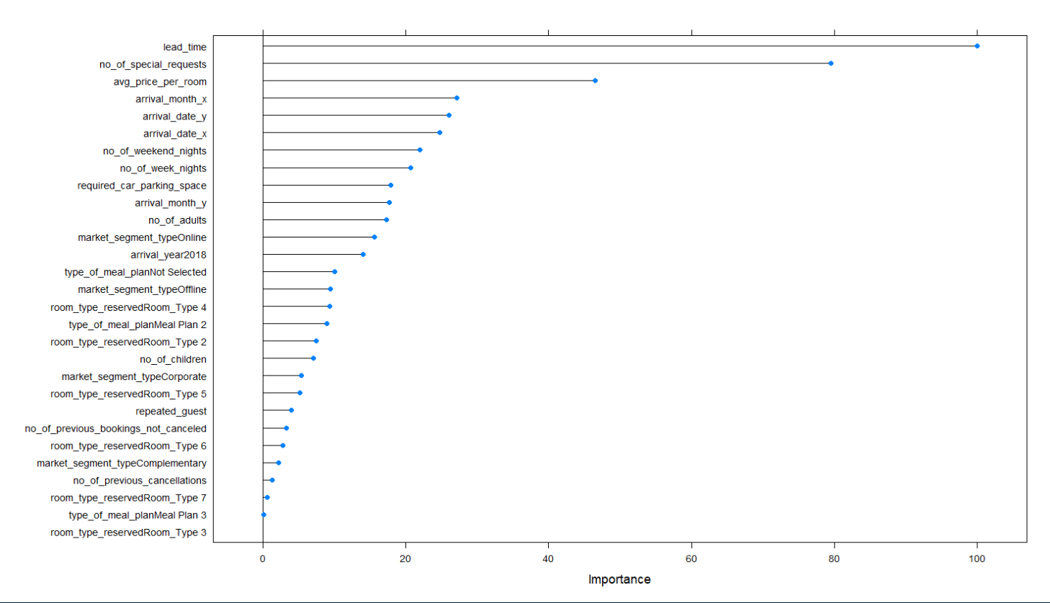
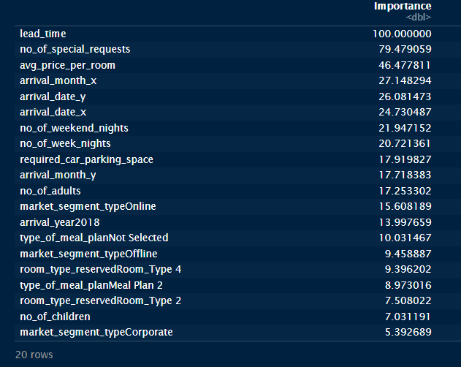
3. Random Forest Model: Variable Importance

Slide 20
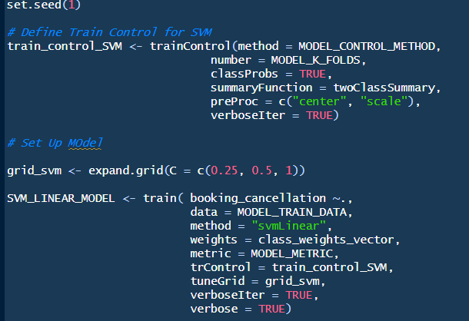
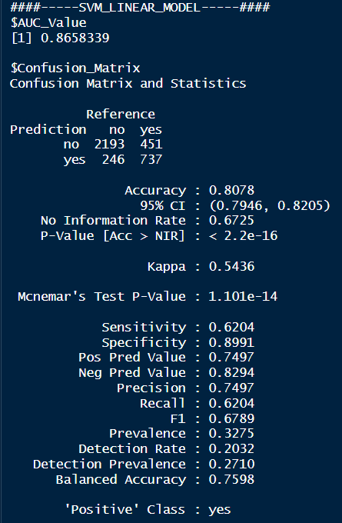
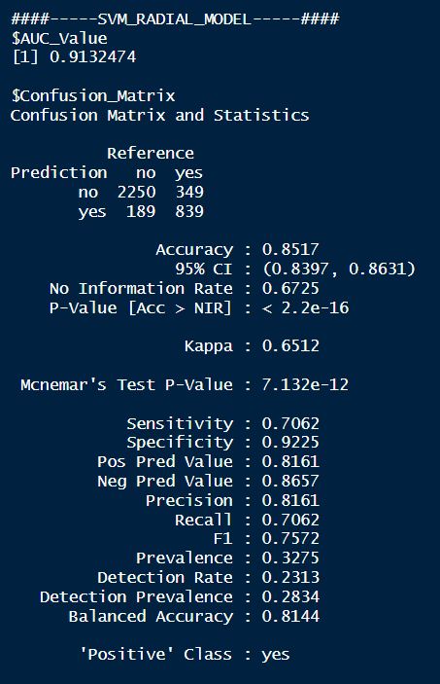
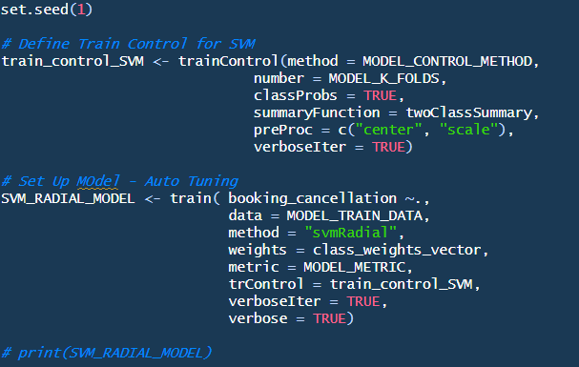
4. Support Vector Machine:
1. Linear Kernel:
Used a vector of 3 C values – (0.25, 0.5, 1) for tuning this model.
2. Radial Kernel:
This model was autotuned.

Slide 21
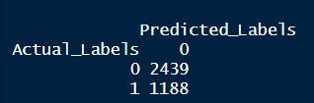
5. Neural Networks:
Creating a dataset for a neural network model is different from creating a dataset for other types of models. Before fine-tuning the model, we first created a simple neural network without considering class weights. However, we noticed that this model mainly predicted the majority class. Below is the confusion matrix for this simple neural network model.

Slide 22
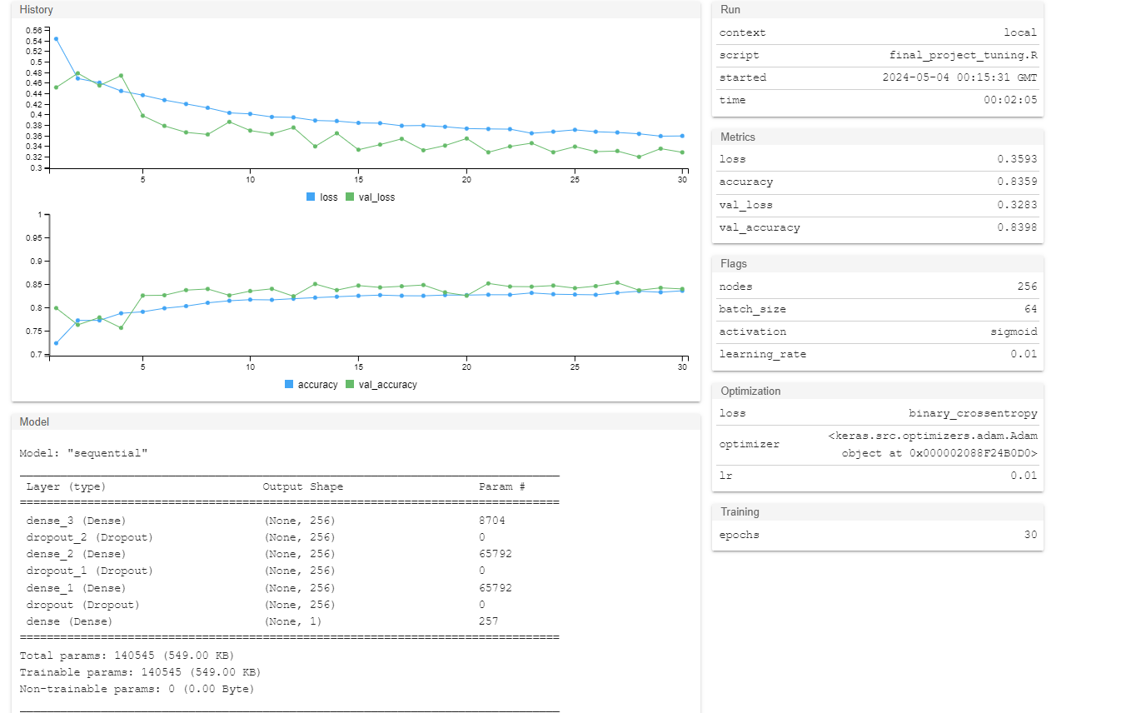
Neural Networks tuned

Slide 23
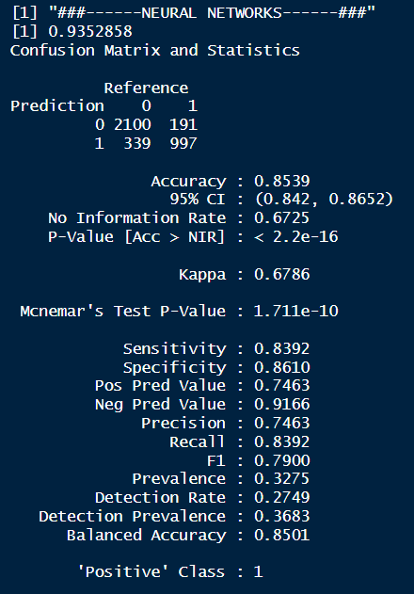
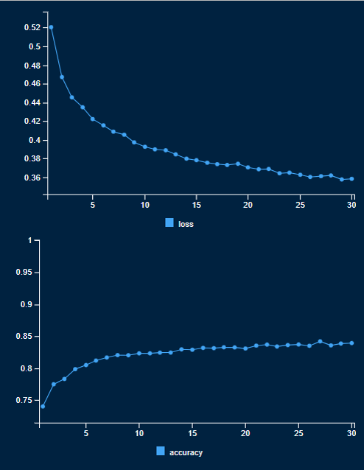
5. Neural Networks:
After configuring the parameters based on the above recommendation below are the results of the final model.

Slide 24
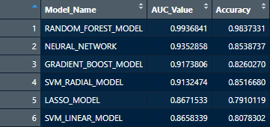
Results:
We evaluated all models based on AUC ROC and Accuracy and compiled the results.
Despite the impressive performance of all classifiers, including Gradient Boost Mode, Neural Networks Model, and Random Forest Model, we opted for the Random Forest Model due to its exceptional performance.
However, when dealing with class imbalance, it becomes imperative to apply class balancing techniques during the modeling process, such as Upsampling/Downsampling or Class Weights based process.
This ensures that the classifiers maintain general success and accuracy, even in scenarios with imbalanced class distributions.

Slide 25
Conclusion
The models utilized in this analysis have demonstrated effectiveness in predicting cancellations, with the Random Forest model yielding the most favorable results.
Key factors influencing room reservations include lead time, average price per room, and the number of special requests.
We recommend that the organization providing the dataset on Kaggle consider implementing a follow-up with customers 123 days after booking to confirm their intentions. This proactive approach can help reduce cancellations and enhance overall customer satisfaction.

